Slide 1
Ayur Chikitsa - A Wellness/Holistic Centre:
A Novel Initiative for Mental Health Care in India

Slide 2
Team No. 44
Team Name:
Member 1 Name: SONIA SATAM
Member 2 Name: AARYA KAMDAR

Slide 3
Content
Business Understanding
Insights about data
EDA - Exploratory Data Analysis
Remedial Measures
Model Building and Deployment
Evaluation of the model
Inferences

Slide 4
Business Understanding
1. Customer Segments:- Target individuals interested in Ayurveda, particularly those seeking natural remedies for mental health.
2. Value Propositions: - Ayurveda's holistic approach to mental health includes personalised dosha balancing, dietary recommendations, herbal remedies, and lifestyle changes.
- "Sattvic" living to promote mental clarity and emotional balance.
3. Channels: - Using online platforms to provide virtual consultations with Ayurvedic practitioners.
- Creating informative content for social media and your website, explaining Ayurvedic concepts related to mental health.
4. Customer Relationships: - Providing ongoing support with follow-up consultations and educational resources on Ayurveda for mental health.
5. Key Activities: - Performing thorough Ayurvedic examinations to identify the imbalances (Vikriti) and distinct constitution (Prakriti) of each individual.
- Creating personalized Ayurvedic treatment regimens that include dietary changes, lifestyle advice, and herbal remedies.
6. Key Partnerships: - Collaborate for ongoing professional development and knowledge exchange with Ayurvedic specialists or schools.
- Work together with yoga establishments to provide yoga and Ayurvedic programs that are integrated for mental health.

Slide 5
B2C (Primary):
Customers: Individuals seeking mental health services.
Focus: Personalized care, holistic approach, affordability, accessibility, trust, and confidentiality.
Marketing: Targeting individuals through online channels, social media, influencers, and community events.
B2B (Potential):
Customers: Organizations (Corporations, Educational Institutions, NGOs).
Focus: Customized wellness programs, data-driven insights, tailored solutions for employee or student well-being.
Marketing: Collaboration with HR and educational departments, highlighting expertise and positive impact.
B2G (Potential):
Customers: Government Agencies.
Focus: Public health initiatives, subsidized services, alignment with government priorities.
Marketing: Participation in government tenders, showcasing compliance, and emphasizing social impact.

Slide 6
INSIGHTS ABOUT THE DATA:
1.Prevalence of Chronic Diseases:
- Cardiovascular Disease and Diabetes are among the most reported chronic conditions.
- Chronic Obstructive Pulmonary Disease (COPD), Asthma, Arthritis, and Chronic Kidney Disease are also present but with lower frequencies.
2. Living Arrangements and Health Conditions:
- Individuals living in Nuclear and Solo arrangements commonly report Chronic Diseases.
- Roommates and Joint Family setups also show prevalence but to a lesser extent.
3. Age-wise Health Trends:
- Cardiovascular Disease and Diabetes are more prevalent in the age group of 45-64.
- Asthma is reported more in the 25-34 age group.
- Chronic Kidney Disease tends to be reported by individuals aged 55-64.
4. Income and Chronic Conditions:
- Individuals with higher reported incomes also report Chronic Diseases, indicating that these conditions affect people across various income levels.
5. Sleep Duration and Health Conditions:
- Individuals reporting higher sleep durations generally have good psychological health.
- Cardiovascular Disease and Diabetes are reported across various sleep durations.

Slide 7
6.Frequency of Healthcare Visits:
- Most individuals report healthcare visits on a quarterly or biannual basis.
- Regular healthcare visits are more common among individuals with Chronic Diseases.
7. Diet Plan and Obesity:
- Individuals following a diet plan tend to have a lower prevalence of obesity.
- Presence of obesity is generally associated with not following a diet plan.
8. Physical Activity and Lifestyle:
- Individuals engaged in physical activity tend to have better psychological health.
- Smoking and alcohol consumption are reported, but their association with specific health conditions is not explicitly stated.
9. Geographical Variation:
- Different states exhibit varying patterns in reported health conditions, indicating potential regional health disparities.
10. Temporal Trends:
- While there is information from multiple years, and changes over time.

Slide 8
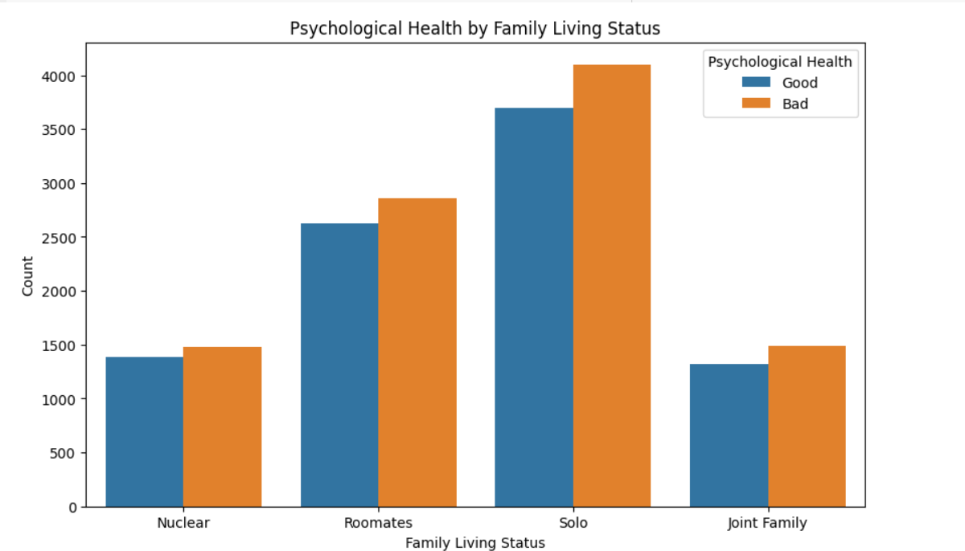
EXPLORATORY DATA ANALYSIS
1)The plot shows the distribution of psychological health by family living status. The majority of people with "Good" psychological health live with their spouse and children, while the majority of people with "Average" and "Poor" psychological health live with their parents or other relatives. This suggests that family living status may be a factor in psychological health, with people who live with their spouse and children being more likely to have "Good" psychological health than those who live with their parents or other relatives.
There are a few possible explanations for this. One possibility is that people who live with their spouse and children have more social support and companionship, which can help to improve their psychological health. Another possibility is that people who live with their spouse and children are more likely to be in a stable and supportive relationship, which can also contribute to good psychological health. Finally, it is also possible that people who live with their spouse and children have more financial resources, which can give them access to better healthcare and other resources that can help to improve their psychological health.

Slide 9
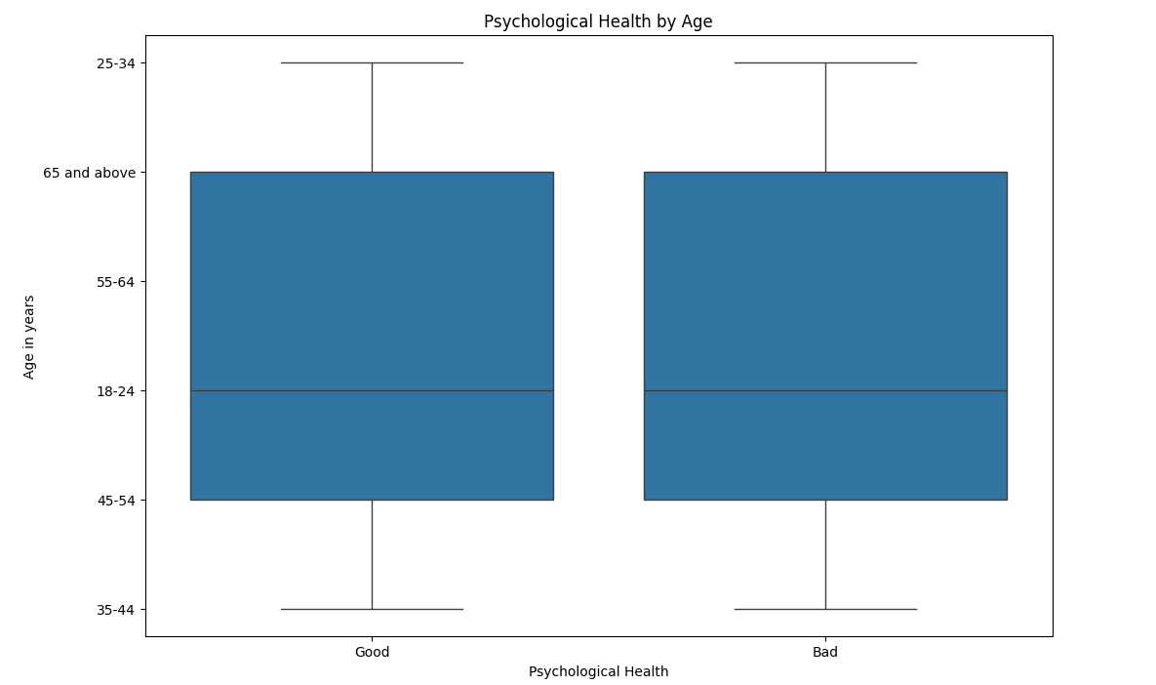
2)The boxplot shows the distribution of age in years for each level of psychological health. The median age is highest for people with "Good" psychological health, followed by those with "Average" and "Poor" psychological health. The interquartile range (IQR) is also largest for people with "Good" psychological health, indicating that there is a wider range of ages in this group. This suggests that age may be a factor in psychological health, with older adults being more likely to have "Good" psychological health than younger adults.

Slide 10
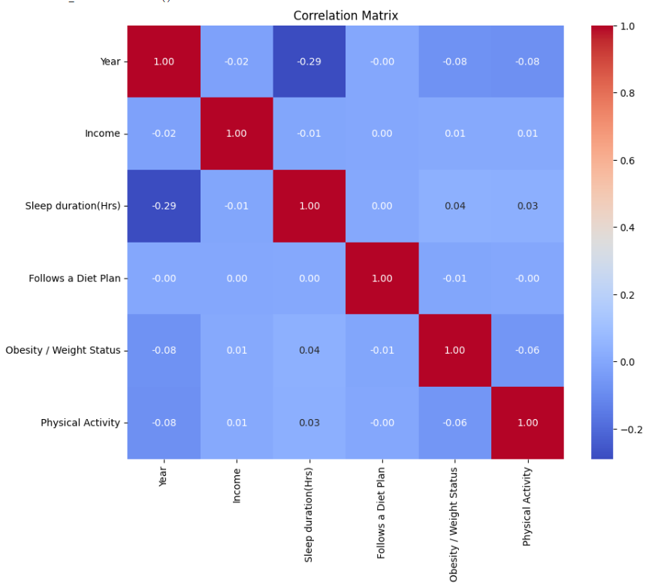
3) The heatmap analysis reveals significant correlations between various variables:
Positive correlations:
Age and Sleep duration: Older individuals tend to sleep longer.
Income and Following a Diet Plan: Higher income correlates with adherence to diet plans.
Frequency of healthcare visits and Obesity/Weight Status, and Physical Activity: More frequent healthcare visits correlate with higher obesity rates and increased physical activity.
Negative correlations:
Age and Psychological Health: Older age associates with poorer psychological health.
Income, Following a Diet Plan, Obesity/Weight Status, and Physical Activity with Psychological Health: Lower income, not following a diet plan, obesity, and less physical activity are linked with poorer psychological health.

Slide 11
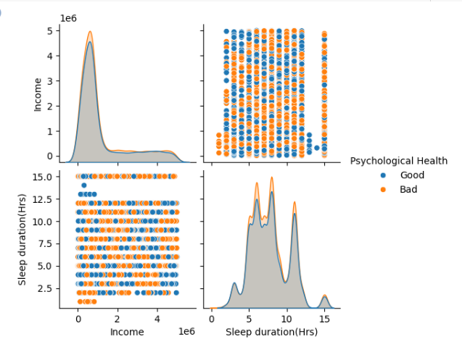
4) The pairplot analysis reveals correlations:
Age and Income: Older individuals have higher incomes.
Age and Sleep duration: Older individuals sleep more.
Psychological Health and Income: Higher income associates with better psychological health.
Psychological Health and Sleep duration: Longer sleep duration links to better psychological health.
Income and Sleep duration: Higher income correlates with less sleep.

Slide 12
REMEDIAL MEASURES
1. Promoting Healthy Sleep: Raise awareness about the importance of adequate sleep and establish flexible work hours to accommodate different sleep schedules. Encourage individuals to follow good sleep hygiene practices, such as maintaining a consistent sleep schedule and creating a comfortable sleep environment.
2. Addressing Socioeconomic Disparities: Implement policies to support those with lower incomes, such as providing access to affordable healthcare, housing assistance, and job training programs. Ensure equitable access to mental health services, as individuals with lower incomes may face barriers to seeking help.
3. Health Promotion: Develop initiatives to promote physical activity and healthy eating habits, targeting communities across different socioeconomic backgrounds. Foster community support networks to provide social connections and resources for mental health support.
4. Policy Changes and Advocacy: Advocate for policies that improve healthcare access and address social determinants of health, such as income inequality and affordable housing. Work towards systemic changes to create a more equitable society where all individuals have the opportunity to thrive.
5. Research and Evaluation: Conduct research studies to further understand the complex relationships between socioeconomic factors, sleep quality, and psychological well-being. Evaluate the effectiveness of interventions through rigorous research methodologies to inform evidence-based practices and policy decisions.

Slide 13
Model Building and Deployment,Evaluation of the model and Inferences
XGBoost model, which achieved an accuracy of 89.5%.
The confusion matrix shows that the model correctly predicted 88 instances of class 0 and 91 instances of class 1. However, it misclassified 5 instances of class 0 as class 1 and 16 instances of class 1 as class 0.
The classification report provides additional insights into the model's performance, indicating high precision, recall, and F1-score for both classes.
Inferences:
The model demonstrates good overall performance with balanced precision, recall, and F1-score for both classes.
The misclassifications highlighted in the confusion matrix suggest areas where the model can be improved, potentially by collecting more data or fine-tuning hyperparameters.
In summary, the XGBoost model shows promising results in accurately classifying instances, with balanced performance metrics across both classes.

